Slide 1


Are you a SOLID developer?
Hello! I am
Kshamesh Atnoorkar
Lead Frond End Developer

Slide 2
Pain points in legacy code
Why SOLID Design Principles?
Single Responsibility Principle
Open/Closed Principle
Liskov Substitution Principle
Interface Segregation Principle
Dependency Inversion Principle

Slide 3
Pain points in legacy code

Slide 4

Pain points in legacy code
Read the code multiple times to understand your scope of change.
Hard to understand what a method does.
Spend more time to fix a minor bug
Struggle to realize any side effects of bug fix.
Refactoring is expensive

Slide 5

Pain points in legacy code
Rigidity
Fragility
Immobility
Needless complexity
Needless repetition

Slide 6
Why SOLID Design Principles?

Slide 7

Why SOLID Design Principles?
Best practices to write an understandable, maintainable and flexible software design.
Easier to extend existing system quickly with breaking it, makes our life easier
Code easier to read, understand and spend less time to for developing solutions
Introduced by Robert C. Martin (Uncle bob) in his book Agile Principles, Patterns and Practices in C#, (named by Michael Feathers)

Slide 8
Single Responsibility Principle

Slide 9





Single Responsibility Principle
A class should have only one, and only one, reason to change.

Slide 10
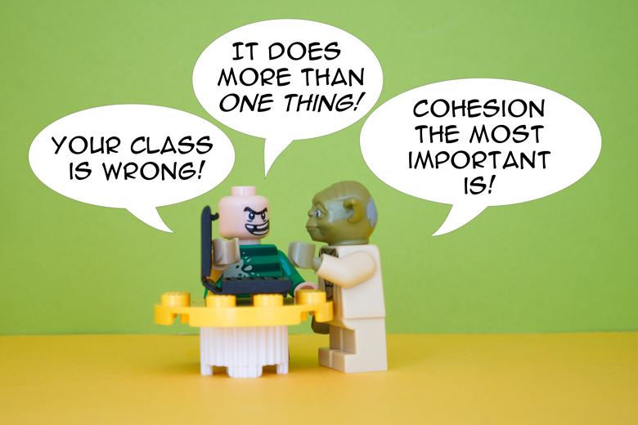
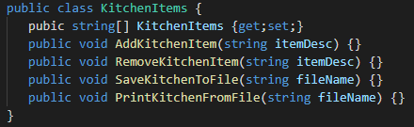
Single Responsibility Principle

Slide 11
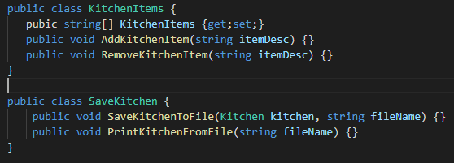
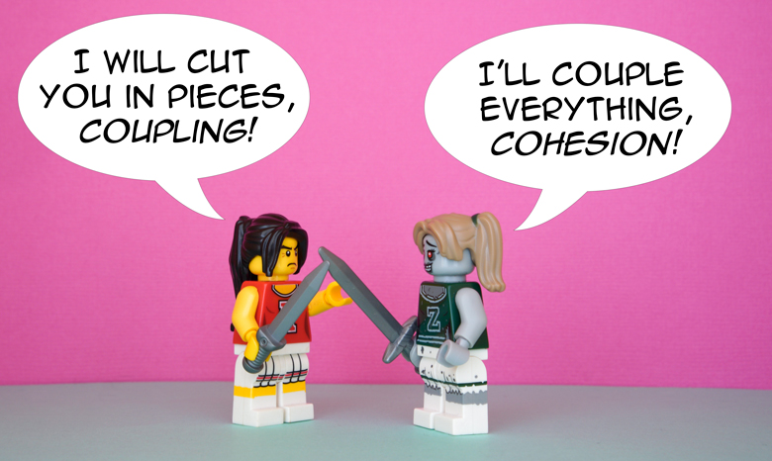
Single Responsibility Principle

Slide 12
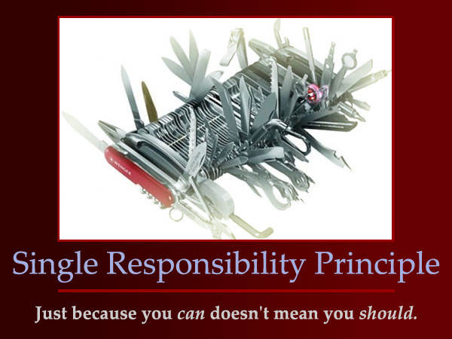
Single Responsibility Principle
Why is it useful?
A class should be responsible for one thing at a one time.
Fine one reason to change, else take everything else out of the class.
Changes in one feature won’t impact another feature.
Separation of concerns.
Separate Unit Test Cases.
Less error prone

Slide 13
Open/Closed Principle

Slide 14



Open/Closed Principle
An entity should be open for extension, but closed for modification

Slide 15
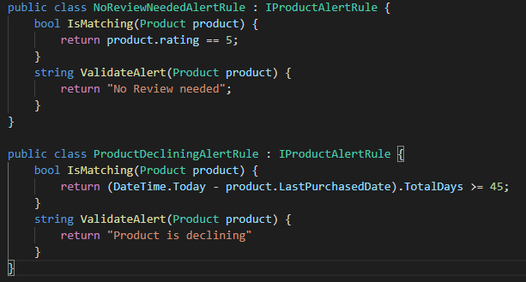
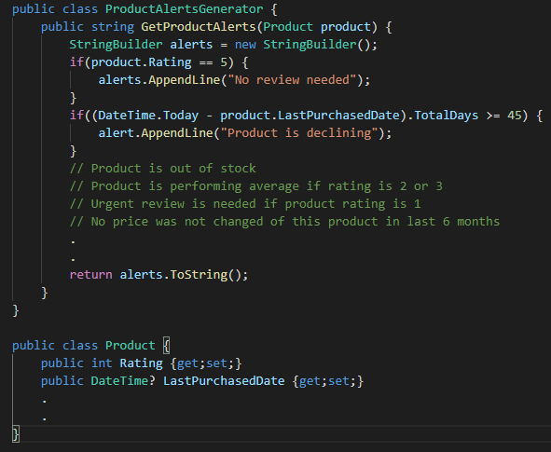
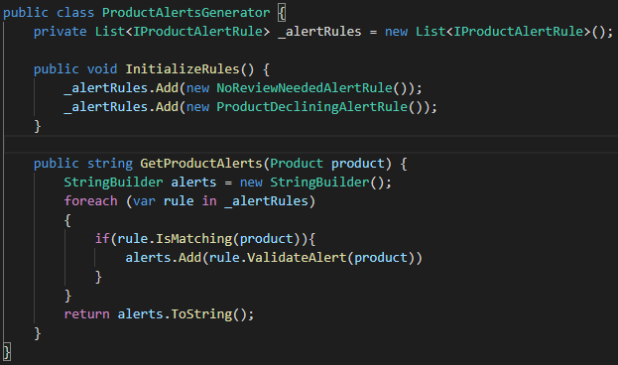
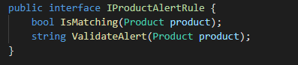
Open/Closed Principle

Slide 16
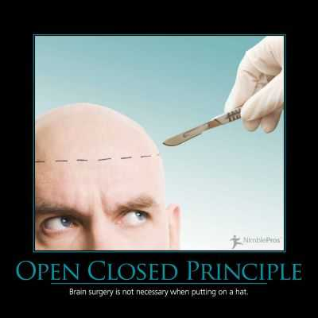
Open/Closed Principle – Why is it useful?
Easily extend the functionality without changing existing code.
Key goal of this principle, you can never break the core of your system.
By being open to adding new features, the development process is agile.
Produces high quality bug free code that will be appreciated over the time.

Slide 17
Liskov Substitution Principle

Slide 18

Liskov Substitution Principle
Let q(x) be a property provable about objects of x of type T. Then q(y) should be provable for objects y of type S where S is a subtype of T.
Subtypes must be substitutable for their base types.

Slide 19
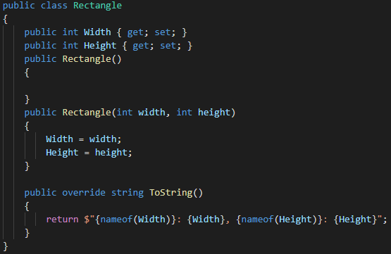
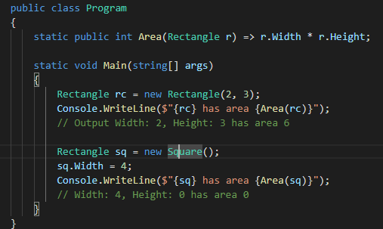
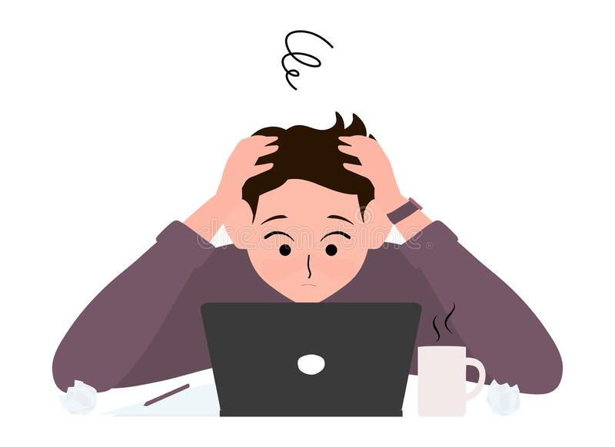
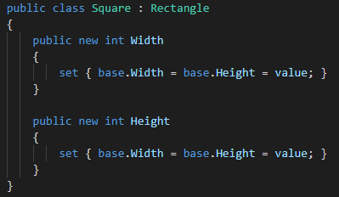
Liskov Substitution Principle

Slide 20


Slide 21
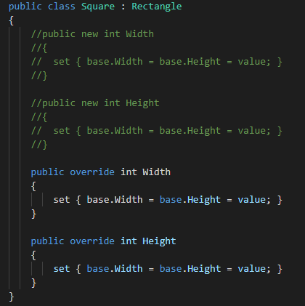
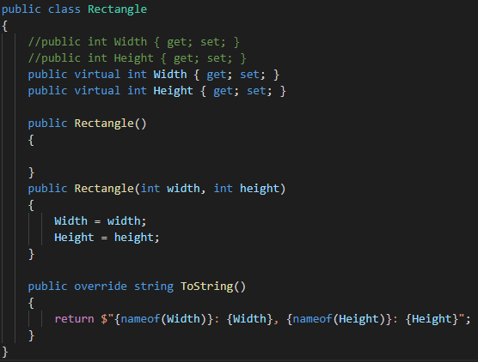
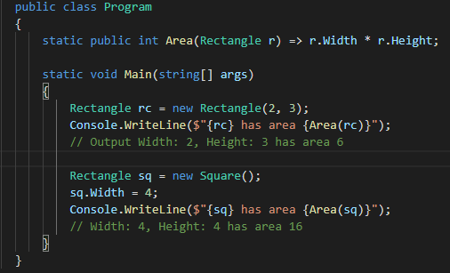
Liskov Substitution Principle

Slide 22
Interface Segregation Principle

Slide 23
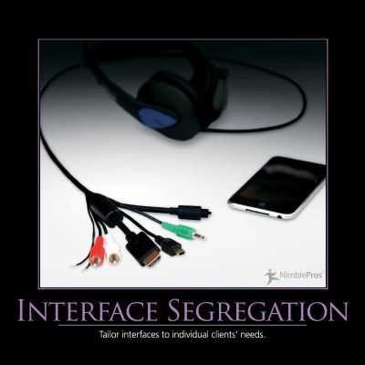
Interface Segregation Principle
A client should never be forced to implement an interface that it doesn’t use, or clients shouldn’t be forced to depend on methods they do not use.

Slide 24
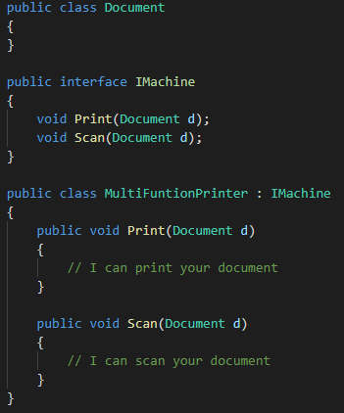
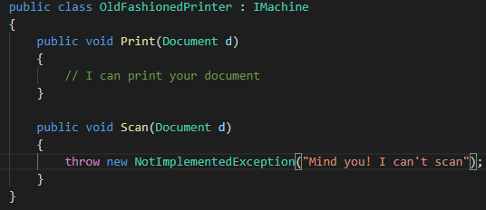


Interface Segregation Principle
Mind you! I can’t scan your document.

Slide 25
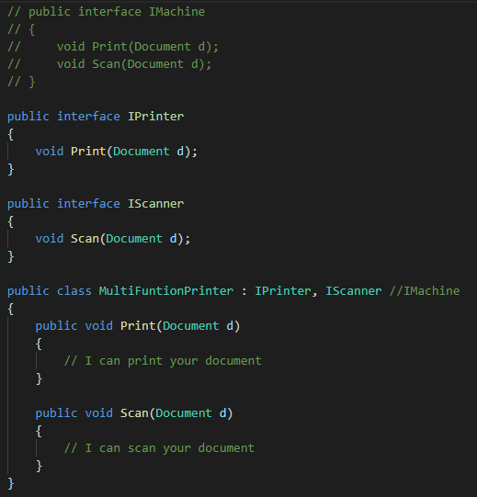
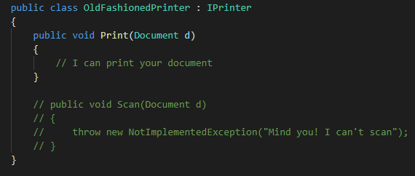

Interface Segregation Principle

Slide 26

Interface Segregation Principle – Why it is useful?
Don’t expose which is not needed by a client.
Clear separation of features.
Better design and can make huge difference between larger code base.
No more fat interfaces

Slide 27
Dependency Inversion Principle

Slide 28
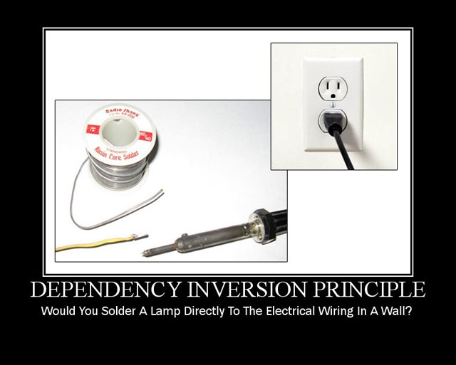
Dependency Inversion Principle
High level modules should not rely on low level modules. Both should depend on abstractions

Slide 29
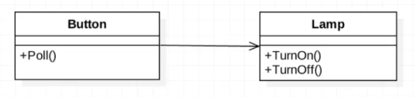
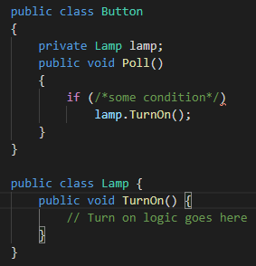
Dependency Inversion Principle
Here the Button which is a higher-level object is depending on a lower-level object the Lamp. The Lamp has a specific TurnOn() and TurnOff() methods.
This is against the Dependency Inversion Principle

Slide 30
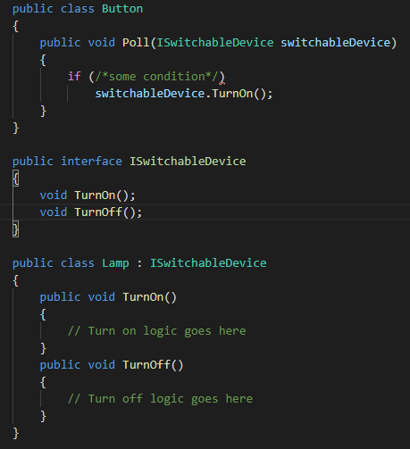
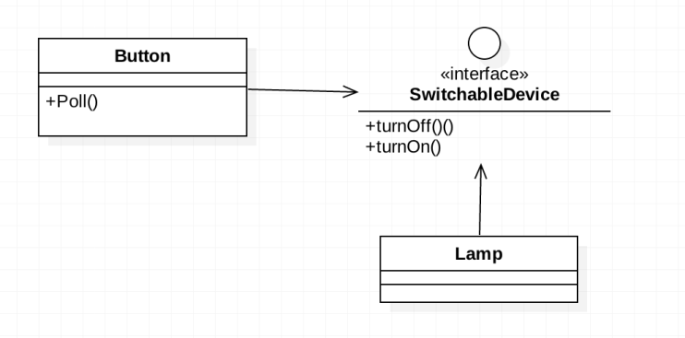
Dependency Inversion Principle

Slide 31
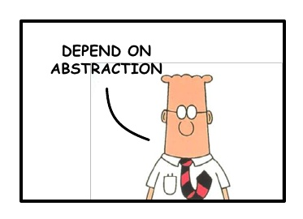
Dependency Inversion Principle – Why is it useful?
Able to change an implementation easily without altering the high-level code.
You can include fans, remotes, lamps, etc.. The Button would not need to know about any of these, and hence is completely decoupled from the lower-level modules
We want the low-level classes like the Lamp to depend (inversely) on our abstraction (SwitchableDevice).

Slide 32
Summary
Single Responsibility Principle
A class should have only one reason to change
Separation of concerns – different classes handling different things, independent tasks/problems
Open/Closed Principle
Classes should be open for extension but closed for modification.
Liskov Substitution Principle
You should be able to substitute a base type for a subtype.
Interface Segregation Principle
Don’t put too much into an interface; split into separate interface.
YAGNI – You Ain’t Going to Need it.
Dependency Inversion Principle
High-level modules should not depend upon low-level ones; use abstraction.

